Slide 1


TUNISIAN REUBLIC
Ministry of Higher Education and Scientific Research
University of Carthage
National Institute of Applied Sciences and Technology
End of studies project
Specialty: Instrumentation and Industrial Maintenance
Oil Site Telemetry System Upgrade
Defended on the 5th of July 2021
Fekri Ben Fatma
Jury members:
President : Mr. Achref SKANDER
Reviewer : Mr. Mohamed Chaker ZAGHDOUDI
Company supervisors:
Ms. Maissa Gasmi | Mr. Wael BEN REJEB
Academic supervisor: Ms. Imen HARBAOUI
Notes:
Hello jury members, hello everyone
Thank you Mr president of the jury for allowing me the opportunity to defend my end of studies project entitled « oil site telemetry system upgrade ».
This project was carried out within Integration Objects, supervised by Mr Wael ben rejeb on behalf of the host company, and Ms Imen Harbaoui on behalf of INSAT, to obtain the national engineering diploma in applied sciences and technologies.

Slide 2

Plan
Solution design
Test and simulation
3
5
Introduction
1
2
4
6
Project scope and study
Implementation
Conclusion and prespectives
Notes:
Our presentation is based on the following plan
Starting with (click) and introduction, and (click) the project scope and study, moving on to (click) the design of the proposed solution followed by (click) its implementation and development and then (click) test and simulation of the proposed solution. To finish with (click) the conclusion and perspectives

Slide 3
1.
Introduction
Notes:
starting with the introduction

Slide 4

1- Introduction
2- Project scope and study
3- Solution design
4- Implementation
5- Test and simulation
6- Conclusion and perspectives
57,3%
Oil and gas demand
Energy needs
Population growth
Notes:
Today, population growth is further increasing the demand for energy so that oil and gas provide (click) 57.3% of the world's energy needs.

Slide 5

1- Introduction
2- Project scope and study
3- Solution design
4- Implementation
5- Test and simulation
6- Conclusion and perspectives
04
Equipment
Environment
Health
Notes:
However, (click) installations in the oil sector are susceptible to hazards that cause harmful effects on (click) equipment, the environment and health.
To limit their consequences, it is necessary to install the most suitable control and safety systems.
This is the context of my final year project at Integration Objects.

Slide 6
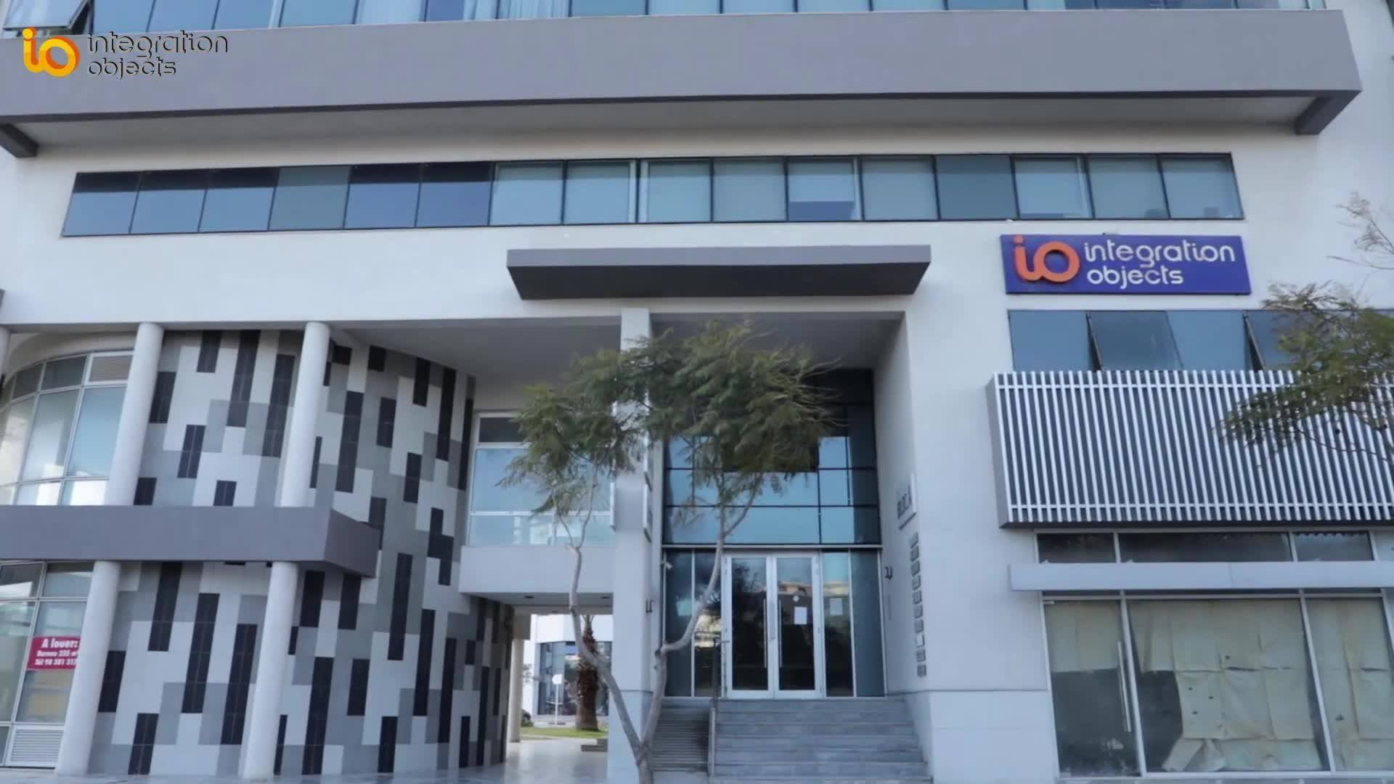




1- Introduction
2- Project scope and study
3- Solution design
4- Implementation
5- Test and simulation
6- Conclusion and perspectives
Host company
Founded in 2002, in Tunisia
Process automation
Command and Control systems
Operational intelligence
Notes:
Integration objects, (click) was founded in 2002 in Tunisia.
It is one of the worldwide leading companies in (click) process automation, (click) command and control systems and (click) operational intelligence.

Slide 7
Host company
1- Introduction
2- Project scope and study
3- Solution design
4- Implementation
5- Test and simulation
6- Conclusion and perspectives
Teams
Design , develop software solutions
Developing unit
Design , integrate, implement, and maintain
Automation unit
Advanced solutions
Design , configure advanced solutions
Notes:
The company’s personnel is divided into 3 teams:
(click) developing unit: whose mission is to design and develop software products for real-time decision-making process and OPC connectivity.
(click) advanced solutions unit: their mission is to design and configure advanced solutions for real-time decision-making process for manufacturing performance optimization
(click) automation unit: its mission is to design, integrate functional testing and implement and maintain control and security systems.
As an intern I was integrated within (click) the automation unit.

Slide 8

Host company
1- Introduction
2- Project scope and study
3- Solution design
4- Implementation
5- Test and simulation
6- Conclusion and perspectives
Company’s reach
Notes:
The company operates in countries in Europe, Africa and all other continents.

Slide 9









Host company
1- Introduction
2- Project scope and study
3- Solution design
4- Implementation
5- Test and simulation
6- Conclusion and perspectives
Clients
Notes:
And some of its clients in the oil and gas sector are:
(click) Petrofac
(click) British petroleum
(click) Total
(click) Saudi Aramco
(click) Esso
And (click) exxonmobil
And more (click) (click)

Slide 10
2.
Project scope and study
Notes:
Moving on the project scope and study

Slide 11
1- Introduction
2- Project scope and study
3- Solution design
4- Implementation
5- Test and simulation
6- Conclusion and perspectives
Industrial Control Systems
Industrial Control systems or ICS:
Broad class of command-and-control networks
Used to support industrial processes
There are several architectures of ICS the most common of which are SCADA based
Notes:
(click) Industrial control systems or ICS is a broad class of command-and-control networks and systems that are used to support all types of industrial processes.
(click) There are several architectures of ICS the most common of which are SCADA based.

Slide 12
SCADA
1- Introduction
2- Project scope and study
3- Solution design
4- Implementation
5- Test and simulation
6- Conclusion and perspectives
Designed to:
Collect
field information
01
Transfer
Information to central computer facility
02
Display
Information to the operator
03
Notes:
SCADA systems are designed to collect field information,(click) transfer it to a central computer facility, (click) and display the information to the operator graphically or textually, allowing him to monitor and control an entire system from a central location in near real time.

Slide 13

1- Introduction
2- Project scope and study
3- Solution design
4- Implementation
5- Test and simulation
6- Conclusion and perspectives
Existing system
Control room
MTU cabinet
Gas Injector
Oil Producer
Manifold
Notes:
This project’s client oil and gas site has several local sites: (click)
Gas injector
Oil producer
Manifold
And Each one of theses sites has several wells
The controllers of these wells communicate with (click) a master controller which collects all the data and sends it to the control room.

Slide 14




1- Introduction
2- Project scope and study
3- Solution design
4- Implementation
5- Test and simulation
6- Conclusion and perspectives
Problematic
Maintenance costs
Spare parts
Manufacturer support
Notes:
(click) These controllers have become obsolete. Which means:
(click) rise in maintenance costs
(click) Scarcity of spare parts
(click) and no manufacturer support
Therefore, (click) the client has brought recourses to Integration objects’ expertise in the field to design and implement an adequate solution to its requests .

Slide 15
Requirements
1- Introduction
2- Project scope and study
3- Solution design
4- Implementation
5- Test and simulation
6- Conclusion and perspectives
Upgrade of local panels
Design of the MTU cabinet
client
Design of a server cabinet
Engineering of inter-site communication
Notes:
To meet client requirements, we need to :
(click) Upgrade the controllers inside the local control panels
(click) Design an MTU cabinet inside the technical room
(click) Design a server cabinet inside the control room
(click) And engineer and design a new inter-site communication architecture

Slide 16
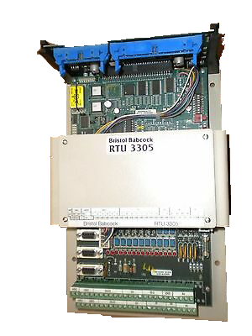
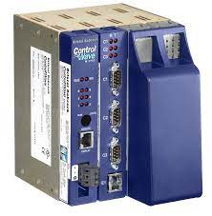
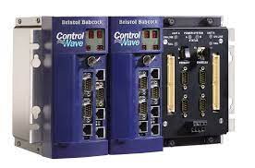
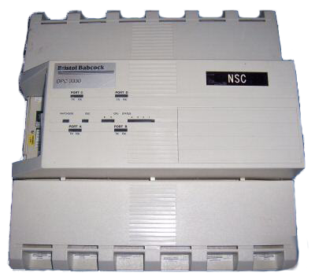
Solution
1- Introduction
2- Project scope and study
3- Solution design
4- Implementation
5- Test and simulation
6- Conclusion and perspectives
From
To
Notes:
For the upgrade, we will be changing (click) the existing remote telemetry unit to a controlwave micro controller. A hybrid controller that combines the capabilities of an RTU and a PLC.
The existing (click) master telemetry unit will be changed to a controlwave redundant controller. A high-performance controller with redundant power supply and CPU.
The radio modems will be upgraded to MDS SD4 and MDS master station.

Slide 17
Steps
1- Introduction
2- Project scope and study
3- Solution design
4- Implementation
5- Test and simulation
6- Conclusion and perspectives
01
02
03
Client specifications
System architecture
I/O list
06
05
04
Electrical diagrams
Heat dissipation
Power consumption
07
08
Control logic
SCADA and HMI
Notes:
In order to realize this project, we had to go through the following steps:
(click) analyze the client specifications
And then (click) design the new system architecture
Followed with (click) the extraction of the inputs and outputs list
After that (click) we moved on to defining the power consumption
And (click) draw the power distribution and cabinet arrangement diagrams
To (click) studying the heat dissipation in the cabinets
(click) then we configured the control logic of the controllers
And finally comes (click) the SCADA configuration and HMI displays design

Slide 18
3.
Solution design

Slide 19
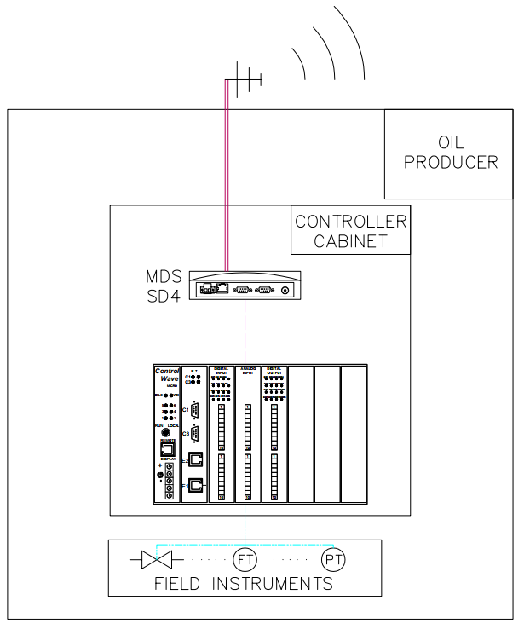
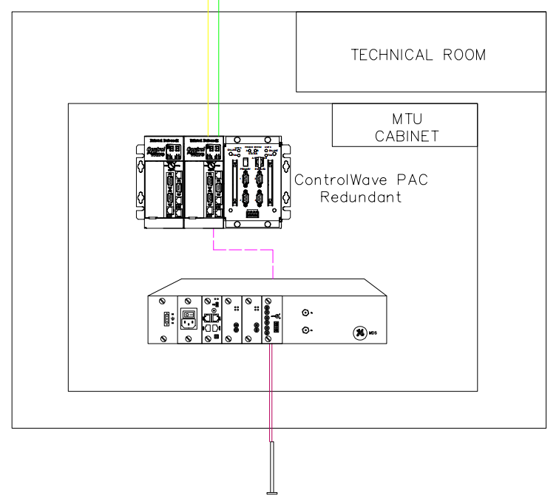
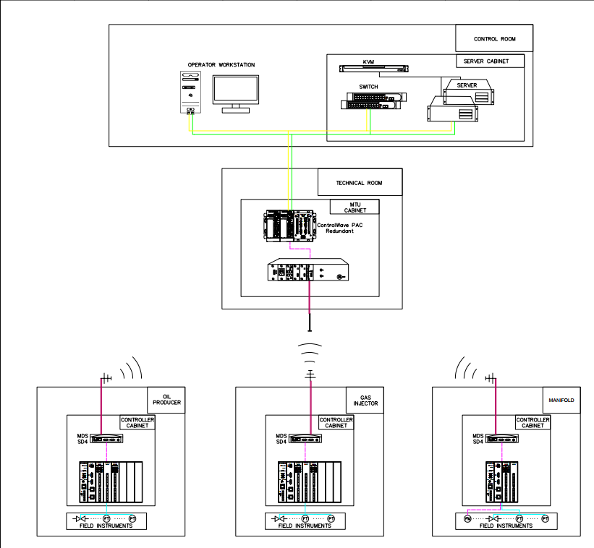
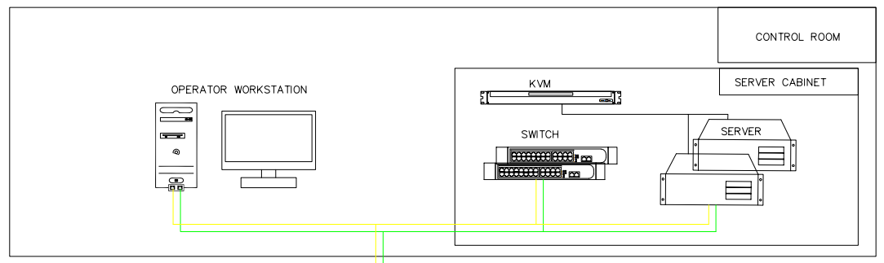
System architecture
1- Introduction
2- Project scope and study
3- Solution design
4- Implementation
5- Test and simulation
6- Conclusion and perspectives
Notes:
To begin, we have designed the general architecture of our solution.
At the field level (click) there are local control panels in which the RTU and radio module are mounted. The field instruments collect data and send it to the RTU via electrical signals, which then transfers it to the radio modem via serial communication; To be finally sent by the antenna via radio frequencies to the MTU cabinet.
(click) The MTU cabinet is in the technical room. In which we have a ControlWave Redundant as an MTU and MDS master station as a radio master module. This module receives the data sent from the different local panels and transfers it the MTU via serial communication. The controller then sends the data to the server in the server cabinet via redundant ethernet communications.
(click) In the control room we have the operator workstation and the server cabinet in which the server, switch and a KVM are mounted.

Slide 20
Inputs and outputs
1- Introduction
2- Project scope and study
3- Solution design
4- Implementation
5- Test and simulation
6- Conclusion and perspectives
Tags
Instrument type
Pressure transmitter, flow transmitter, switch…..
1
2
4-20mA, 5VDC, 24VDC…
Signal type
Digital or analog
Input or output
I/O type
4
3
Notes:
After defining the architecture, we went on to extracting the system’s inputs and outputs. For this we need to specify:
(click) The tag
(click) The instrument type: such as pressure transmitters, flow transmitters and switches
(click) Io type whether it’s digital or analog, input or output
(click) Signal type : 4-20mA for example

Slide 21
Inputs and outputs
1- Introduction
2- Project scope and study
3- Solution design
4- Implementation
5- Test and simulation
6- Conclusion and perspectives
15
10
5
0
13
12
Analog inputs
11
7
Digital inputs
5
Digital outputs
3
3
3
Oil Producer
Gas Injector
Manifold
Notes:
After careful examination of the existing controllers’ logic and the wiring diagrams. We were able to determine the needed input and output signals for each site(click) . In total for this project, 9 analog inputs, 36 digital inputs, and 12 digital outputs are needed.

Slide 22

Controller configuration
1- Introduction
2- Project scope and study
3- Solution design
4- Implementation
5- Test and simulation
6- Conclusion and perspectives
Local panels
IO modules
 | Gas Injector | Oil Producer | Manifold
8AI module | 1 | 1 | 1
16DI module | 1 | 1 | 1
16DO module | 1 | 1
Notes:
According to the IO list extracted we were able to select the necessary input and output modules.
We will be using the (click) 8 analog inputs and the (click) 16 digital inputs modules for all the sites. And the (click) 16 digital outputs module will be used only for the gas injector and oil producer sites.

Slide 23
Controller configuration
1- Introduction
2- Project scope and study
3- Solution design
4- Implementation
5- Test and simulation
6- Conclusion and perspectives
Local panels
Gas Injector
Oil Producer
Manifold
Power supply
CPU
Digital input module
Analog input module
Digital output module
Power supply
CPU
Digital input module
Analog input module
Digital output module
Power supply
CPU
Digital input module
Analog input module
8 slots base housing
8 slots base housing
4 slots base housing
Notes:
And so, we can finally select the size of the base housing:
(click) For the gas injector and the oil producer controllers we need an 8-slot base housing, (click) and for the manifold a 4-slot base housing is sufficient.

Slide 24


Controller configuration
1- Introduction
2- Project scope and study
3- Solution design
4- Implementation
5- Test and simulation
6- Conclusion and perspectives
Local panels
MTU cabinet
ControlWave Micro:
ControlWave Redundant:
150 MHz + 2 Enet
100MHz + 3 Enet
24VDC
24VDC
Notes:
The controlwave controllers come with several configurations.
For local panels we will be (click) using the 24VDC power supply since field panels are supplied with a 24VDC signal.
and the 150MHz cpu to allow for local communication with maintenance laptops via ethernet.
(click) For the MTU cabinet we will be using the 100MHz cpu with 3 ethernet connections and the 24vdc power supply.

Slide 25

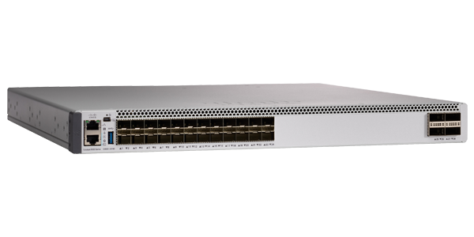
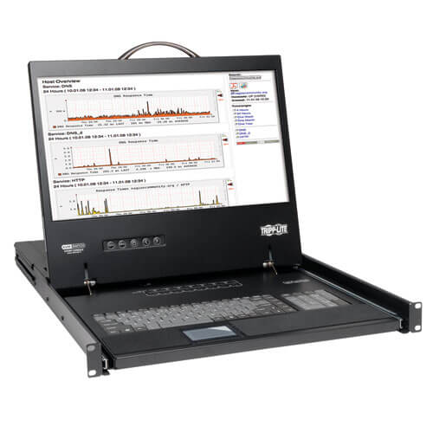
Server cabinet
1- Introduction
2- Project scope and study
3- Solution design
4- Implementation
5- Test and simulation
6- Conclusion and perspectives
Switches
Servers
KVM
Notes:
For the server cabinet the equipment were selected according to the cimplicity V11 software’s system requirements:
And therefore, we will be using:
(click) 2 x Power edge R540 server with 8Go of RAM
(click) And 2 x Cisco C9500 32 switches
(click) A netcontroller 16 port KVM

Slide 26




Heat dissipation
1- Introduction
2- Project scope and study
3- Solution design
4- Implementation
5- Test and simulation
6- Conclusion and perspectives
Notes:
These equipment dissipate heat inside the cabinets. Therefore, a study was performed to determine (click) whether we need ventilation in the cabinets or not.

Slide 27
Heat dissipation
1- Introduction
2- Project scope and study
3- Solution design
4- Implementation
5- Test and simulation
6- Conclusion and perspectives
Cabinet | A(m²) | Qa(W) | Qe(W) | Qv(W)
Manifold | 1.59 | 15.92 | 71.72 | 55.80
Gas Injector | 1.59 | 19.44 | 71.72 | 50.80
Oil Producer | 1.59 | 19.44 | 71.72 | 50.80
MTU | 1.84 | 73 | 83.16 | 10.16
Server | 2.22 | 4482.8 | 149.89 | -4332.90
Notes:
After consulting the manufacturer manuals and technical documents of the cabinets’ components, we managed to determine the power loss of each cabinet Qa.
Then by comparing it to the heat dissipation capabilities of each cabinet Qe, we got the power that needs dissipation. The only cabinet in this project in need of ventilation is (click) the server cabinet since the comparison result is negative, which means that the power loss is greater than the power dissipated by the panel.

Slide 28




Power distribution
1- Introduction
2- Project scope and study
3- Solution design
4- Implementation
5- Test and simulation
6- Conclusion and perspectives
Server cabinet
230VAC
MTU cabinet
24VDC
Local panels
Notes:
Now that the controllers’ configuration has been set, we can define the power distribution of each cabinet.
The local cabinets are supplied with (click) a 24VDC signal coming from a solar panel system.
The (click) MTU and server cabinets are provided with a 230VAC signal from the mains and an uninterruptible power supply ups

Slide 29
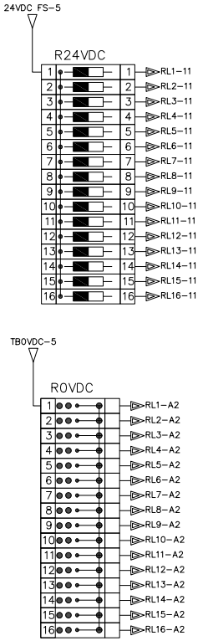
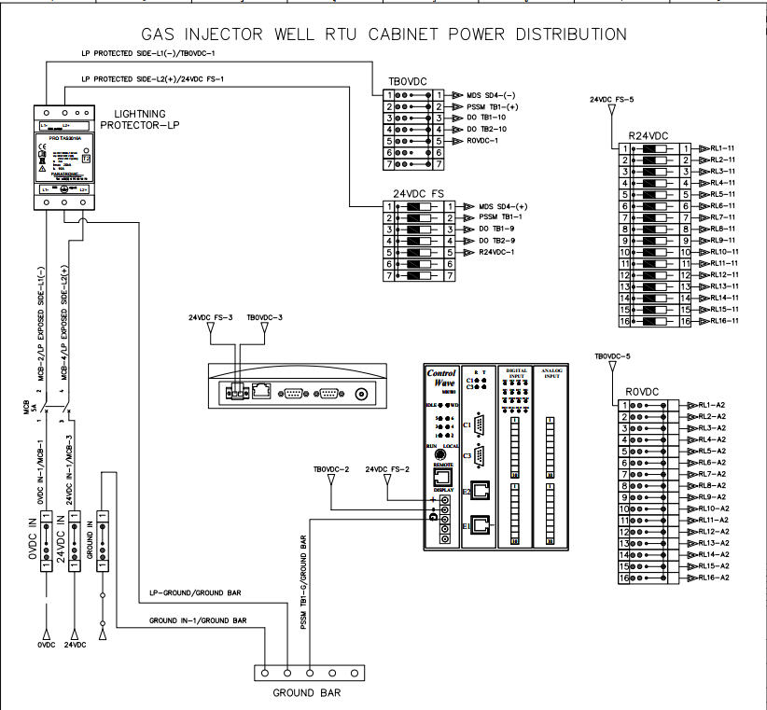
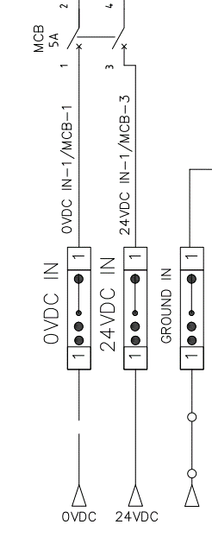
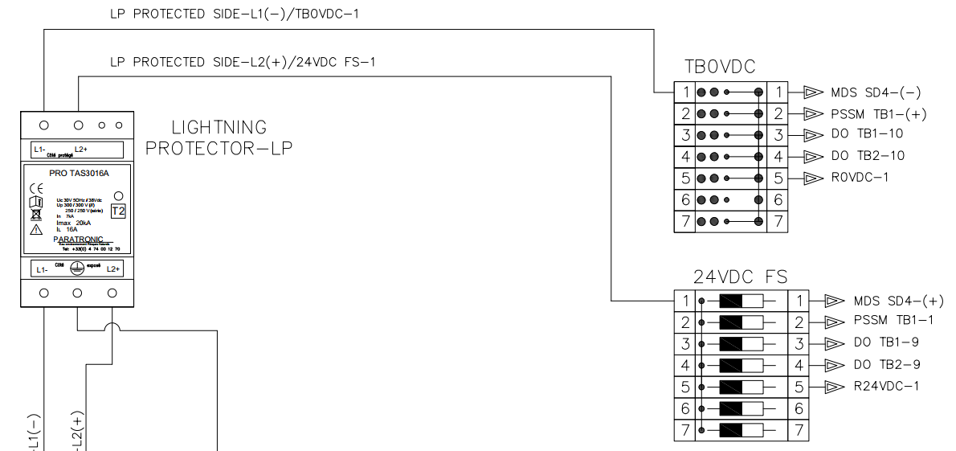
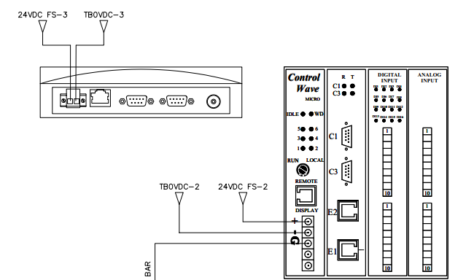
Power distribution
1- Introduction
2- Project scope and study
3- Solution design
4- Implementation
5- Test and simulation
6- Conclusion and perspectives
Local panels
Notes:
This signal enters the cabinet (click) through terminal blocks and then goes to the circuit breaker.
(click) The 24VDC signal then reaches an already existing lightning protector that acts as an isolation between the supply and cabinet sides. Then terminal blocks are used to deliver power to the cabinet’s different components such as (click) the relays for the digital outputs. (click) And the controller and radio modem.

Slide 30
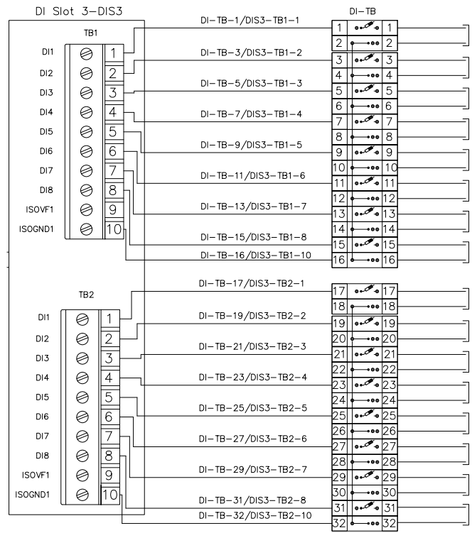
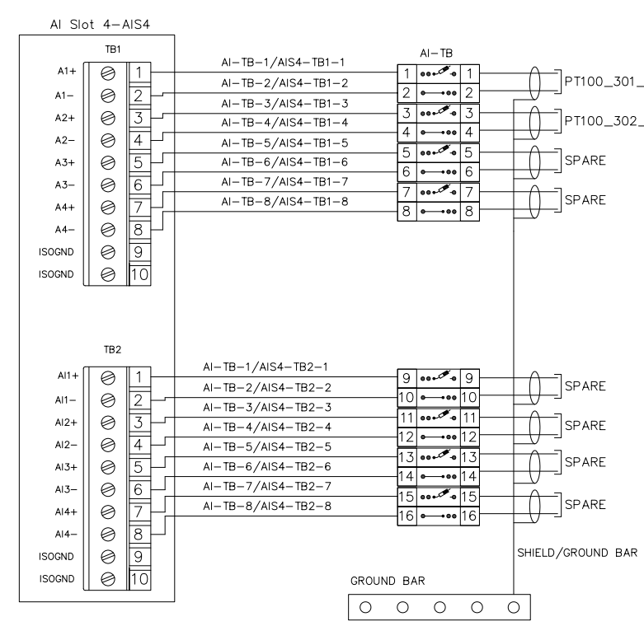
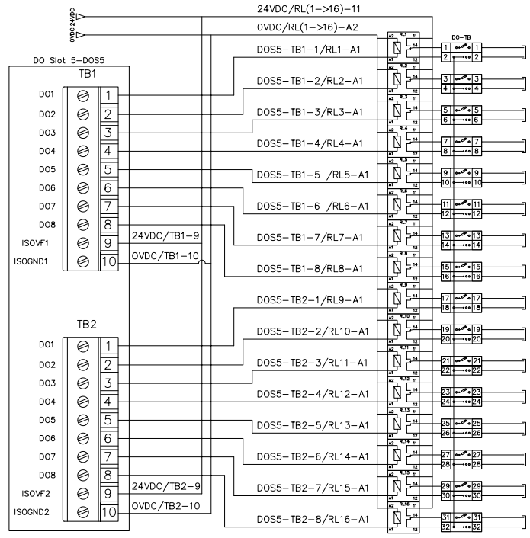
IO termination
1- Introduction
2- Project scope and study
3- Solution design
4- Implementation
5- Test and simulation
6- Conclusion and perspectives
Local panels
Digital inputs
Analog inputs
Digital outputs
Notes:
Input and output terminations are provided to define the wiring of different devices to the IO modules.
For example, (click) in the digital inputs' termination the signal travels from the device through terminal block to the designated pin in the digital input module.
(click) these are the analog inputs
(click) and these are the digital outputs

Slide 31
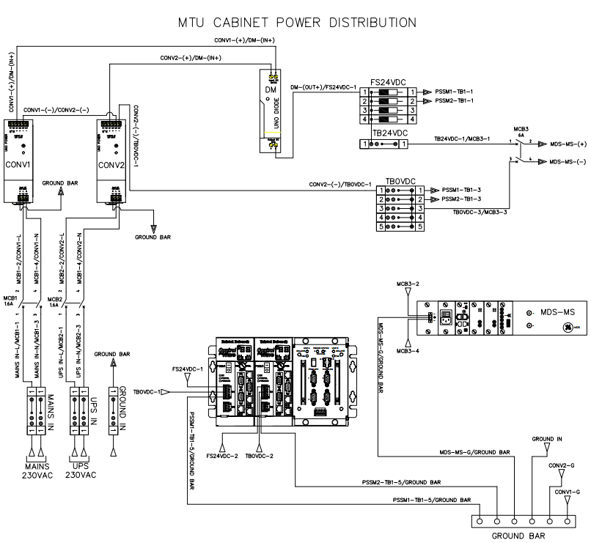
Power distribution
1- Introduction
2- Project scope and study
3- Solution design
4- Implementation
5- Test and simulation
6- Conclusion and perspectives
MTU cabinet
Notes:
In the mtu cabinet the mains and the ups signals go through an AC/DC converter. Then the output 24VDC signals go to the redundancy module to finally reach terminal blocks that feed the cabinet components. The power redundancy is required for a higher system reliability and availability.

Slide 32
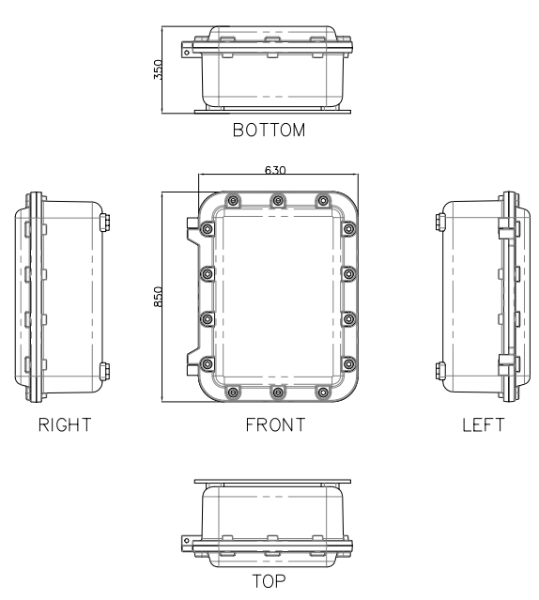
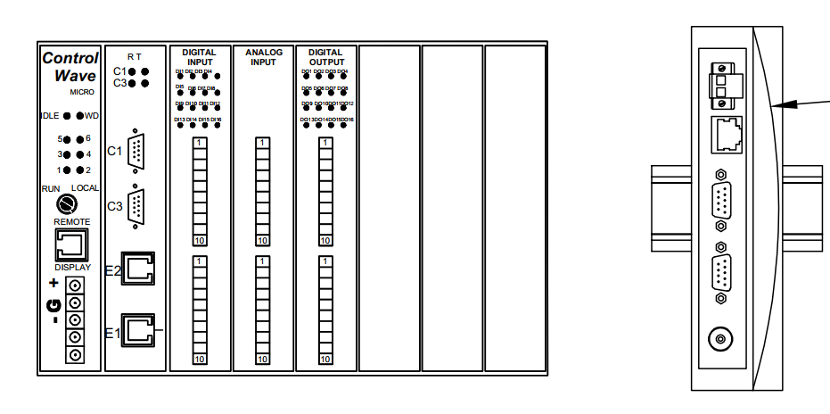
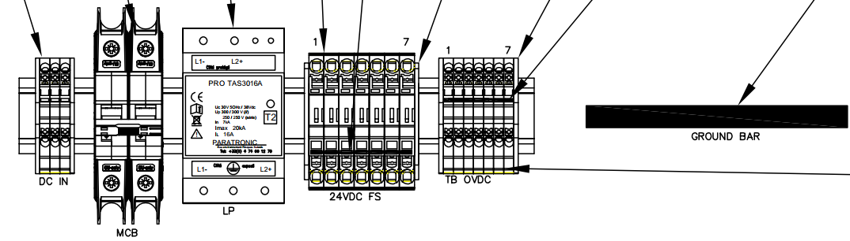
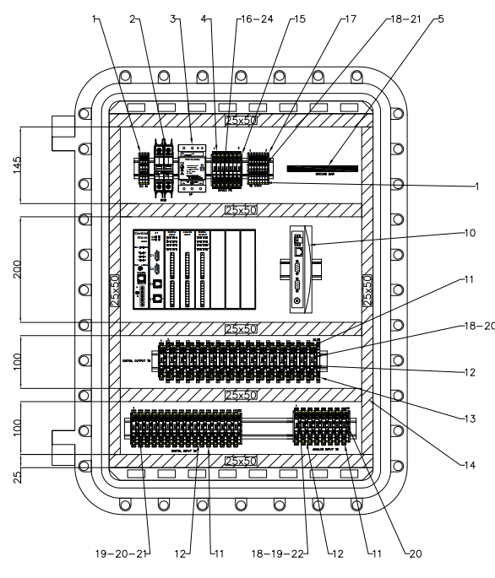
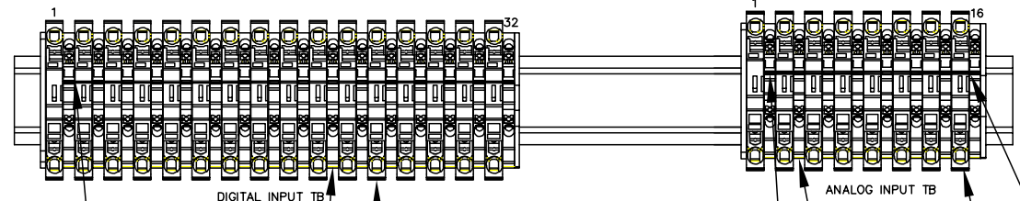
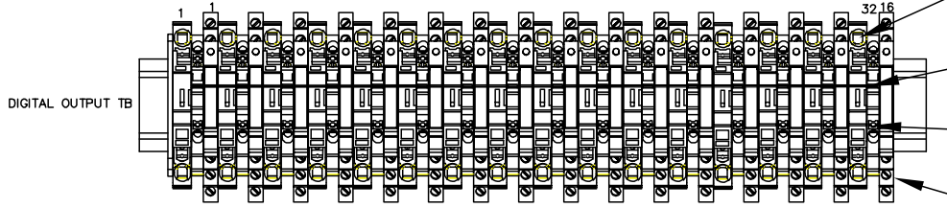
Cabinet arrangement
1- Introduction
2- Project scope and study
3- Solution design
4- Implementation
5- Test and simulation
6- Conclusion and perspectives
Local panels
Notes:
Now that all the cabinet components have been selected and wired together, we can arrange them inside the cabinet.
For the local panels such as the gas injector we chose to use the existing cabinet (click) as it has enough space to house all the components. It is a 850mm BY 630mm stainless steel cabinet with a depth of 350mm.
We have divided the cabinet into 4 sections:
(click) the first section is where we have the power input signal and protection elements such as the circuit breaker
(click) in the second section we have the radio modem MDS SD4 and the controlwave micro
(click) in the third section digital output relays and terminal blocks are mounted
(click) and finally in the fourth section we have the digital and analog inputs’ terminal blocks

Slide 33
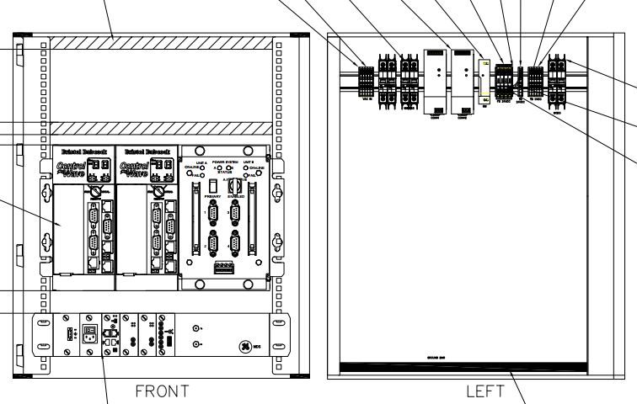
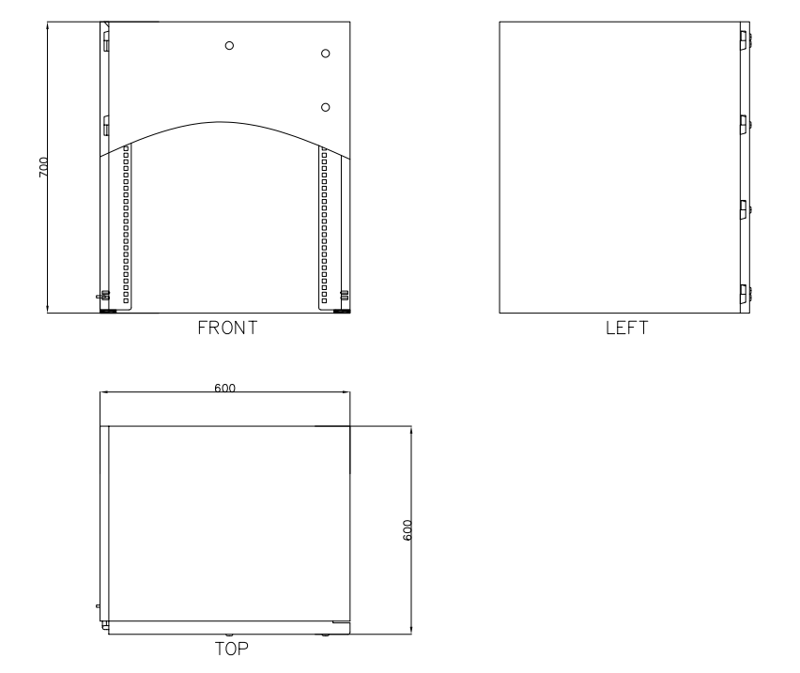
Cabinet arrangement
1- Introduction
2- Project scope and study
3- Solution design
4- Implementation
5- Test and simulation
6- Conclusion and perspectives
MTU cabinet
Notes:
The MTU cabinet was chosen according to the dimensions of the controwave redundant and the MDS master station modem.

Slide 34
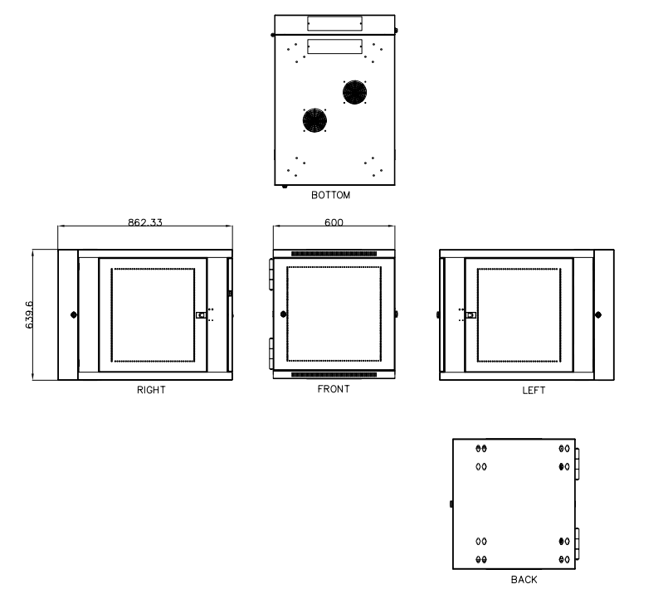
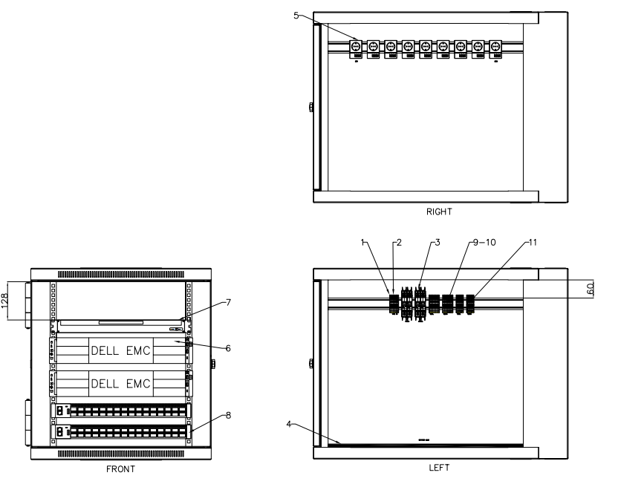
Cabinet arrangement
1- Introduction
2- Project scope and study
3- Solution design
4- Implementation
5- Test and simulation
6- Conclusion and perspectives
Server cabinet
Notes:
Similarly, the server cabinet has been designed and chosen to fit the poweredge servers

Slide 35
4.
Implementation

Slide 36
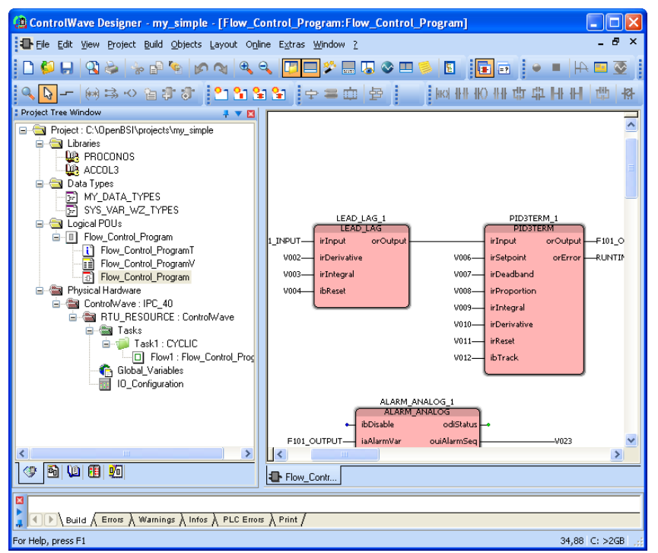

Controller programming
1- Introduction
2- Project scope and study
3- Solution design
4- Implementation
5- Test and simulation
6- Conclusion and perspectives
ControlWave Designer
Notes:
To configure the controlwve controllers we used (click) the openBSI utilities suite. It has a set of services designed for providing access to controlwave RTUs.
One of the services we used is (click) the controlwave designer. This software allows the programming of controllers using the standard programming languages. It allows compiling and downloading the program and has a simulation feature.

Slide 37
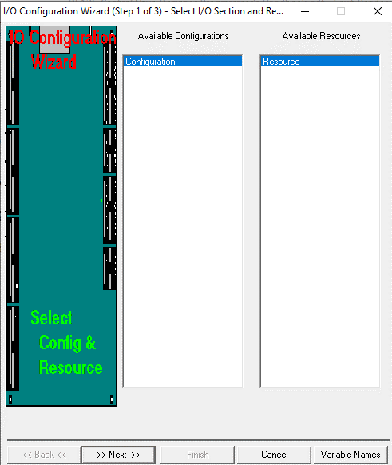
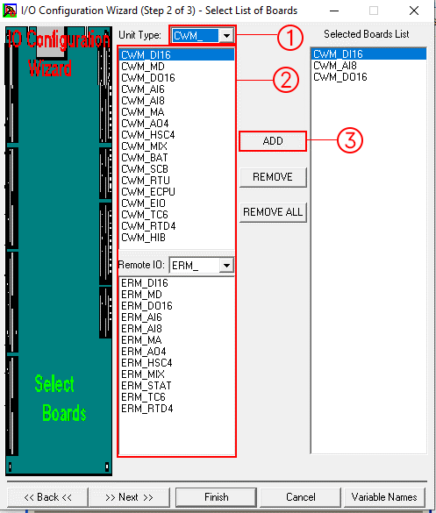
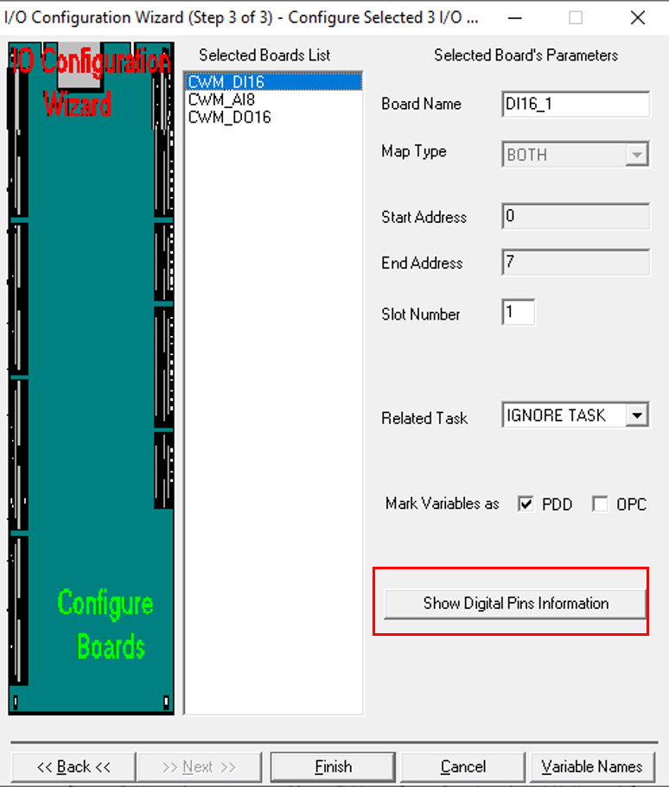
Controller programming
1- Introduction
2- Project scope and study
3- Solution design
4- Implementation
5- Test and simulation
6- Conclusion and perspectives
Input/output modules configuration
Notes:
To configure the controller’s input and output modules we use the I/O configuration wizard. The configuration is done in three steps
(click) First step: selecting from available configurations and resources. It is generally skipped since most projects use a single configuration.
(click) second step: selecting the list of boards used in the project:
By first selecting the controller
Then selecting the board from the list
And then click on add
(click) third step: configuring selected io boards. To do so, we need to click on the show digital pins information button (or equivalent)

Slide 38
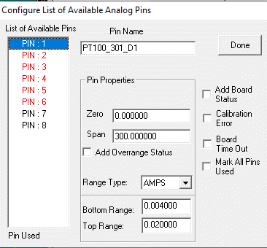
Controller programming
1- Introduction
2- Project scope and study
3- Solution design
4- Implementation
5- Test and simulation
6- Conclusion and perspectives
Input/output modules configuration
Notes:
which takes to the pins configuration window. Such as the analog pins configuration. In this window we can
(click) define pins to use,
(click) add the pin tag
(click) set the range
(click) and the signal type

Slide 39
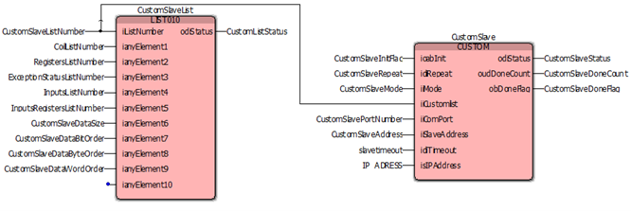
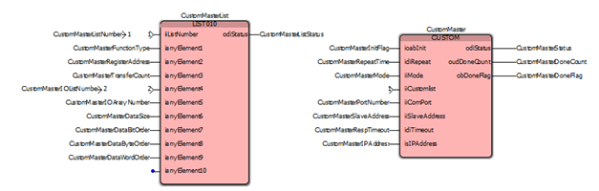
Controller programming
1- Introduction
2- Project scope and study
3- Solution design
4- Implementation
5- Test and simulation
6- Conclusion and perspectives
Modbus communication
Master
Slave 1
Response
Request
Master
Slave
Slave 2
Notes:
As mentioned before, data gathered by the field controllers is sent to the MTU before reaching the SCADA server.
The communication between the RTUs and MTU is achieved via the modbus protocol.
(click) After receiving the master’s request, the slave (click) replies with the requested data.
(click) With this principle we configured the modbus communication of both the master and slave .

Slide 40






SCADA configuration
1- Introduction
2- Project scope and study
3- Solution design
4- Implementation
5- Test and simulation
6- Conclusion and perspectives
3 x control valves
Value
Open state
Closed state
2 x pressure transmitters
Pressure limits alarms
Discrepancy
5 x indicators
Range out alarms
1 x PSD switch
Notes:
The next step is to set up the SCADA system.
With the help of (click) general electric’s software, “Cimplicity”, defining different system parameters and points was possible.
For the gas injector site, we need (click):
3 control valves
2 pressure transmitters
5 indicators
1 PSD switch
For the control valves (click) we will need three Boolean inputs: the open and closed states, and the discrepancy input
For the pressure transmitters(click ) we need an input for the pressure value, and pressure limit and range out inputs for the alarms

Slide 41



SCADA configuration
1- Introduction
2- Project scope and study
3- Solution design
4- Implementation
5- Test and simulation
6- Conclusion and perspectives
Alarms
Battery OK
Power
Control panel/RTU common alarm
Valve discrepancy
Pipe pressure high/low
Pressure range out
Fire detected
Notes:
For the alarms we have 3 classes:
The RTU class (click) which takes care of alarms that are related to the RTU such as power and battery states.
The Valve class (click) for the valve discrepancy state
And finally, the high class (click) for alarms with high priority such as pressure range out and fire detection

Slide 42



SCADA configuration
1- Introduction
2- Project scope and study
3- Solution design
4- Implementation
5- Test and simulation
6- Conclusion and perspectives
Users
Set points
View alarms
Acknowledge alarms
Delete alarms
Set points
View alarms
Acknowledge alarms
View alarms
Acknowledge alarms
Notes:
These alarms and points are accessible by every user type, but each user role has its privileges:
(click) Supervisor with the highest authority can set points, view acknowledge and delete alarms
(click) Engineer has the same privileges except for deleting alarms
(click) and the operator can only view alarms and acknowledge them

Slide 43
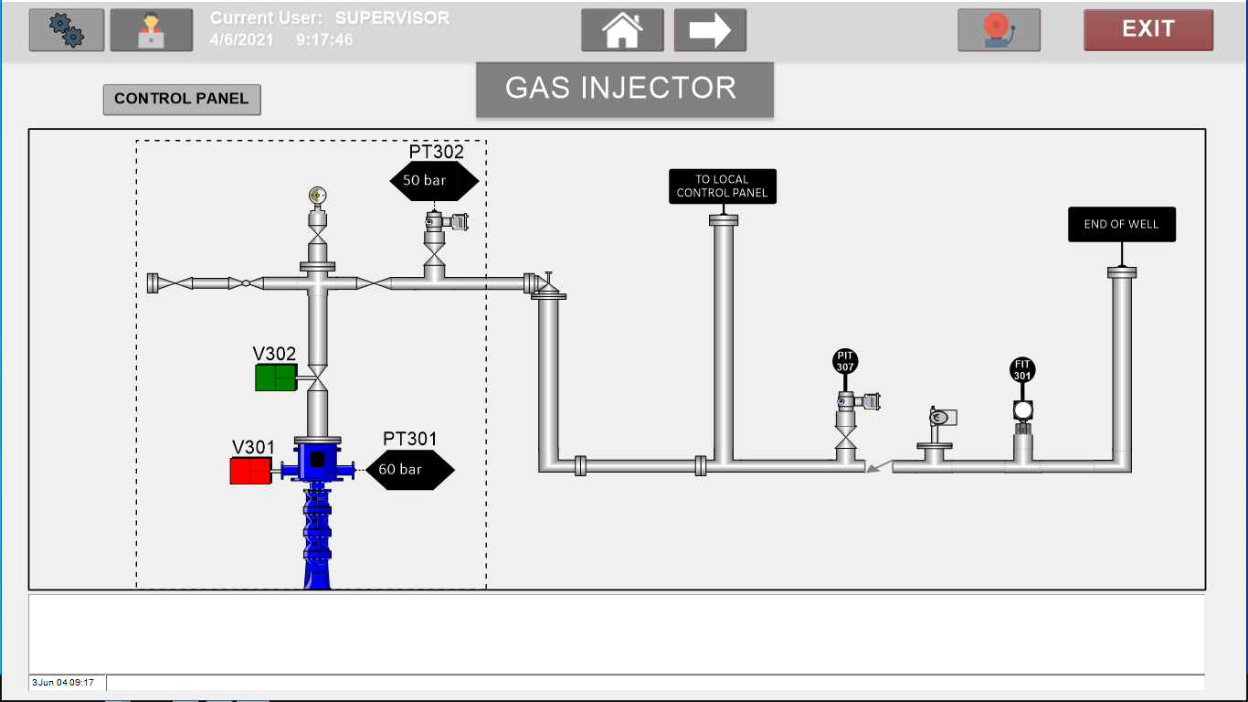
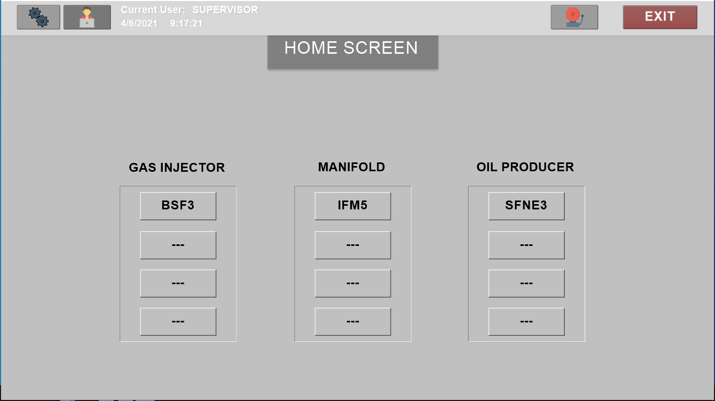
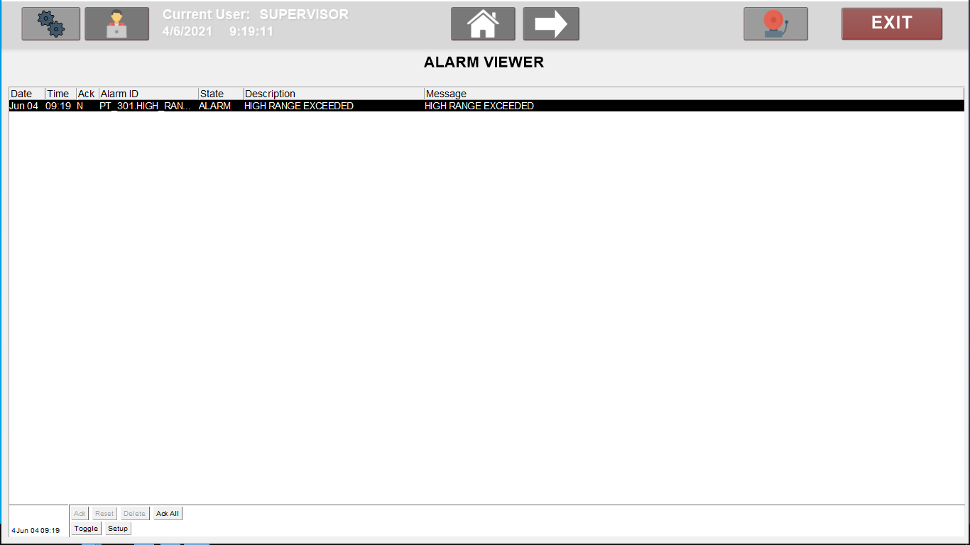
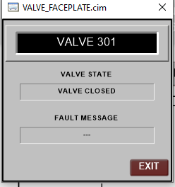
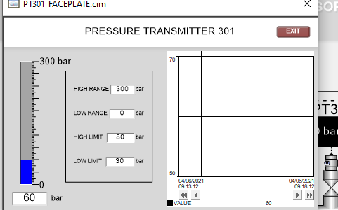
HMI displays
1- Introduction
2- Project scope and study
3- Solution design
4- Implementation
5- Test and simulation
6- Conclusion and perspectives
Notes:
Cimplicity has an integrated HMI designer Which allowed us to create the following displays:
(click) the home screen is where the user can navigate to all the system screens.
If we click on the BSF3 button of the gas injector site for example (click), the well’s screen appears.
In this screen the user can monitor the site’s different devices and indicators such as valves and pressure transmitters.
For more details, every device has a faceplate (click).
He can also view alarms (click) in the alarm box on the bottom of the screen or by going to the alarm viewer screen (click)

Slide 44
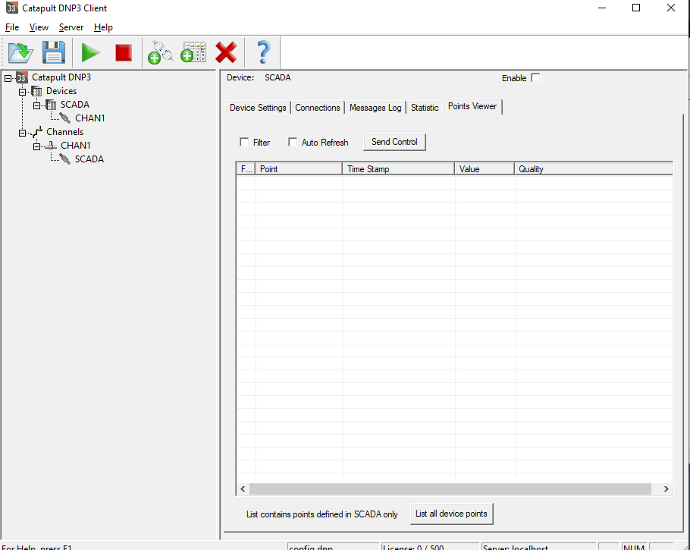

DNP3 configuration
1- Introduction
2- Project scope and study
3- Solution design
4- Implementation
5- Test and simulation
6- Conclusion and perspectives
Notes:
The communication between the MTU and SCADA system is achieved via the DNP3 protocol. Therefore, we had to install the catapult DNP3 driver to be able to integrate the protocol into cimplicity. In which we can configure the DNP3 device and communication channels.
In this communication the MTU will be the slave and the master is the SCADA system.

Slide 45
5.
Test and simulation
Notes:
NOw for the conclusion and perspectives

Slide 46
Communication simulation
1- Introduction
2- Project scope and study
3- Solution design
4- Implementation
5- Test and simulation
6- Conclusion and perspectives
Modbus
Modbus
Not supported
DNP3
DNP3 slave simulator
Notes:
To simulate the modbus communication we need to have the controlwave micro and redundant controllers since the software controlwave designer (click) does not support simulation of virtual communications
(click) For the communication between the MTU and SCADA via DNP3, the simulation is shown in the next video, where the dnp3 simulator is used instead of the MTU controller.

Slide 47

DNP3 Simulation
1- Introduction
2- Project scope and study
3- Solution design
4- Implementation
5- Test and simulation
6- Conclusion and perspectives

Slide 48
6.
Conclusion and perspectives
Notes:
NOw for the conclusion and perspectives

Slide 49






Conclusion
1- Introduction
2- Project scope and study
3- Solution design
4- Implementation
5- Test and simulation
6- Conclusion and perspectives
Analyze client specifications
Design the solution
develop electrical diagrams
Configure controllers
Program the control logic
Design HMI
Notes:
To summarize, in this project we have
(click) Analyzed client specifications
(click) Designed the solution,
(click) developed electrical diagrams
(click) configured controllers
(click) programmed the control logic
(click) and designed the HMIs
To meet client requirements

Slide 50
Perspectives
1- Introduction
2- Project scope and study
3- Solution design
4- Implementation
5- Test and simulation
6- Conclusion and perspectives
Downloading the control logic into the controllers and testing the system’s operation
Realizing FAT and SAT tests
Building the cabinets
Notes:
The next steps for this project are:
Downloading the control logic into the controllers and testing the system’s operation
Realizing the factory acceptance test and the site acceptance test
Building and wiring the cabinets

Slide 51

Notes:
thank you for your attention

